Slide 1
An Ontological Representation of Interface Patterns in Context of Interface Adaptation for Users with Special Needs
Volgograd State Technical University
Software Engineering department
M. Kultsova, A. Potseluico, A. Usov, A.Anikin

Slide 2
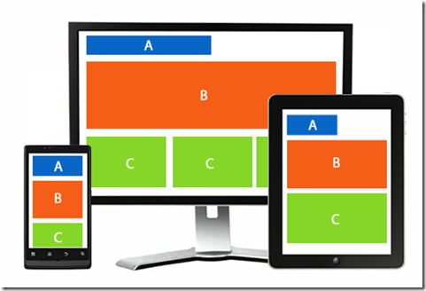
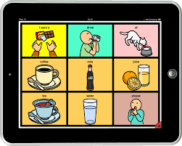
The main problems of developers
Problem of collecting information about users’ disabilities and added problems
Problem of understanding the end users needs
Problem of setting properties of UI-components
Problem of misunderstanding the value of changing interface in real time
Notes:
Сказать, что проблемы, связанные с разработкой пользовательских интерфейсов, связаны с тем, что разработчики не уделяют должного внимания нижеуказанным проблемам.

Slide 3
User-Centered Design*
Fundamental principles of User-Centered Design:
Ensure the project understands what the users want or need to achieve and the environment in which they work or live.
Ensure the designers know who the users are and how the system should fit into their lives or their work.
Make the demonstration of the software prototype as soon as possible.
Have a flexible team that can understand and address all aspects of the users’ experience with the system.
*ISO 9241-210:2009
Notes:
В нашем исследовании мы использовали UCD, основные принципы которого заключаются в следующем:

Slide 4
The concept of adaptive interfaces creation
Quality model of software products (ISO9126) :
functionality
portability
maintainability
efficiency
reliability
usability
Usability of an interface(ISO9241):
effectiveness
efficiency
user satisfaction
Notes:
Юзабилити = результативность + эффективность + удовлетворенность пользователей процессом выполнения поставленной задачи в определенной среде. В данном стандарте принимаются во внимание ресурсы, которые были потрачены на создание интерфейса. Компонентам удобства использования стандарт дает определения: результативность -- точность и полнота, с которой указанные пользователи могут выполнить определенные задачи в определенных средах; эффективность -- ресурсы, затраченные на точность и полноту достигнутых целей (временные, материальные и человеческие ресурсы); удовлетворенность -- удобство и приемлемость работы системы для пользователей и других людей, взаимодействующих с системой. Юзабилити интерфейсов, созданных нашей системой будет достигаться с помощью данной концепции, которая состоит из 4 онтологических моделей и одной базы паттернов.

Slide 5
Description of the meta-ontology
Requirements for the ontological model:
The ontology must represent the user's disorders and their degrees
The ontology must represent sets of widgets for input and output of information on the interface
The ontology must represent the characteristics of the user's device
The ontology must represent user problems on the current interface
The ontology must represent solutions to the problems of interaction problems between user and interface
Meta-ontology (IDEF5)
M=< O_{M}, C, Inst, R, I >,
where M – meta-ontology;
O_{M}={O_{User}, O_{Dis}, O_{Int}, O_{Dev}} – set of ontologies, O_{User}- user ontology, O_{Dis}- ontology of user’s disorders,
O_{Int}– ontology of interface, O_{Dev}– ontology of device;
C – the final set of meta-ontology concepts, C=∅;
Inst – the final set of meta-ontology instances, Inst=∅;
R = {has, impacts on} – the final set of meta-ontology relations between instances;
I – the final set of interpretation rules, I=∅.

Slide 6
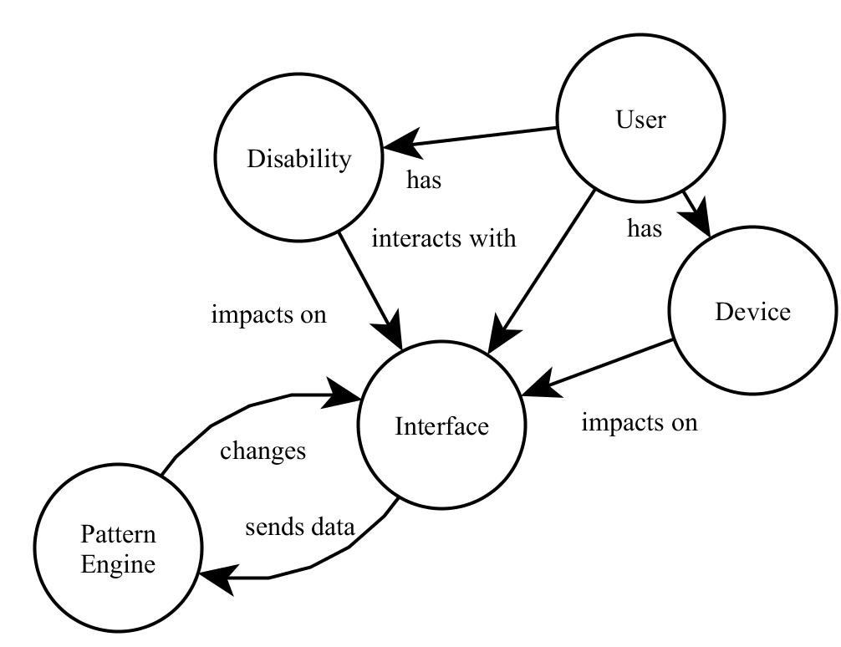
Description of improved the meta-ontology
Requirements for the ontological model:
The ontology must represent the user's disorders and their degrees
The ontology must represent sets of widgets for input and output of information on the interface
The ontology must represent the characteristics of the user's device
The ontology must represent user problems on the current interface
The ontology must represent solutions to the problems of interaction problems between user and interface
The ontology must represent the database of patterns
Improved Meta-ontology (IDEF5)
M=< O_{M}, C, Inst, R, I >,
where M – meta-ontology;
O_{M}={O_{User}, O_{Dis}, O_{Int}, O_{dev,} , O_{p,}} – set of ontologies, O_{User}- user ontology, O_{Dis}- ontology of user’s disorders,
O_{Int}– ontology of interface, O_{Dev}– ontology of device, O_{P}– ontology of patterns;
C – the final set of meta-ontology concepts, C=∅;
Inst – the final set of meta-ontology instances, Inst=∅;
R = {has, impacts on, interacts with, changes, sends data} – the final set of meta-ontology relations between instances;
I – the final set of interpretation rules, I=∅.

Slide 7
Model of the interface pattern
P = < N, Pr, C, S>,
where N – name of a pattern;
Pr – the problem solved by this pattern;
C – pattern condition;
S – the solution applied to the interface.
Name of the pattern | Increasing the size of the widget
Problem | People with moderate and severe motor disability can click around the widget instead of clicking on it.
Condition | IF (user. hasProblem(Moderate Tremor) OR user. hasProblem(Severe Tremor)) AND ClickCount > 3
Solution | Widget.Increase Size(25%) IF Widget.hasTextComponent() {Widget.IncreaseTextComponent(25%)}
Notes:
В нашей системе мы использовали только 4 паттерна – паттерн увеличения размера шрифта, паттерн блокировки кнопки по нажатию, паттерн определения клика по кнопке и паттерн использования картинки вместо текста.

Slide 8
New Pattern Representation
The process of pattern applying

Slide 9
Tracking events
Click on the widget event
Click on the area near widget event
Time between clicking on the same widget
Time of pressing any interactive widget
Time of typing text in text widgets
Time between text appearing and any response on it
Time of task performing

Slide 10
New Pattern Representation
The relationships between meta-ontology concepts(IDEF5)

Slide 11
Pattern Types
The ontology model of pattern types(IDEF5)

Slide 12
Attribute Pattern
The ontology model of Attribute Pattern(IDEF5)

Slide 13
View Pattern
The ontology model of View Pattern(IDEF5)

Slide 14
Exchange Pattern
The ontology model of exchange pattern(IDEF5)

Slide 15
Plans for the future work
Bug-fix of the system
Improvement of interface for developers
Adding database of patterns and change pattern representation inside the system
Adding mechanism of collecting user actions
Implementing system for applying interface patterns
15

Slide 16
Approbation of the work
The main provisions of the thesis were presented at four conferences:
XX Regional Conference of Young Researchers of the Volgograd Region (Volgograd, December 8-11, 2015) - 3rd place
The 53rd Scientific Intra-University Conference (Volgograd, Feb. 5, 2016)
7th International Conference on Information, Intelligence, Systems and Applications (IISA) (Chalkidiki, Greece 13-15 July 2016)
Student competition of student work (Volgograd, May 16, 2017) - 1st place

Slide 17
^{Thanks for attention!}

