Slide 1
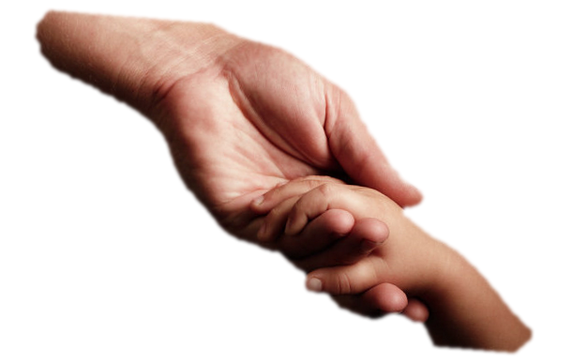
Web-service for translation of pictogram messages into Russian coherent text
Marina Kultsova * Dmitry Matyushechkin * Anton Anikin
Volgograd State Technical University Volgograd, Russia
Email: marina.kultsova@mail.ru

Slide 2
Alternative communication systems
Augmentative and alternative communication (AAC) is an umbrella term that encompasses the communication methods used to supplement or replace speech or writing for those with impairments in the production or comprehension of spoken or written language
Notes:
People with IDD (Intellectual and developmental disabilities) infrequently can use usual verbal speech to communicate with others. There are a lot of different ways to augment or completely replace verbal speech for people with IDD as picture and symbol communication boards and electronic devices.
This may help to express themselves and increase social interaction, school performance, and feelings of selfworth.

Slide 3
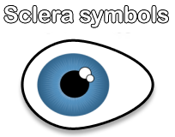
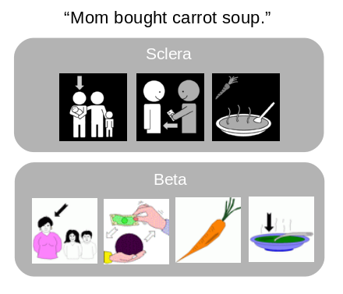
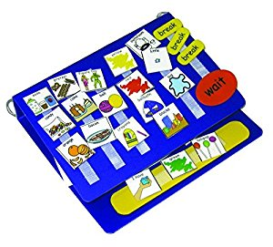
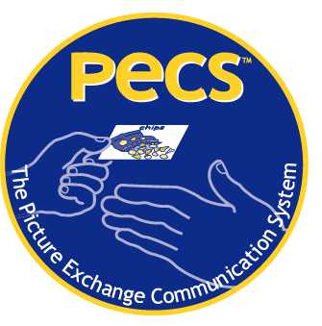
Alternative communication systems
Pictograph exchange system encourages and models speech along with the picture exchange. There are different pictogram sets and notations like Sclera, Beta, and PECS
BETA
Notes:
One of the popular ways to provide communication without speech is using pictures instead of words.
It is possible to exchange a picture to request an item, to comment on or describe something, and eventually to have a conversation.
Pictograph exchange system encourages and models speech along with the picture exchange. There are different pictogram sets and notations like
Sclera, Beta, and PECS

Slide 4
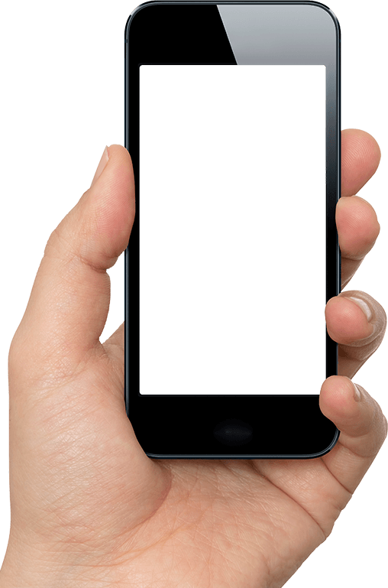
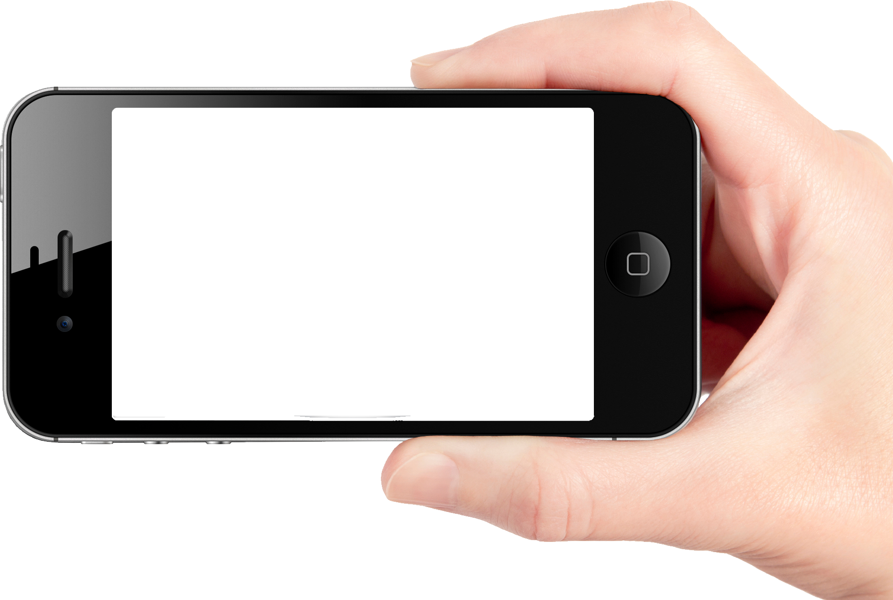
Text to pictographs translation
I want a red apple
Notes:
During the development applications for RUSSIAN users with IDD, the problem has appeared which concerns translation text messages in Russian into pictograph messages and vice versa. Currently, there are a number of systems and web services that implement this function for various European languages but not for Russian.

Slide 5
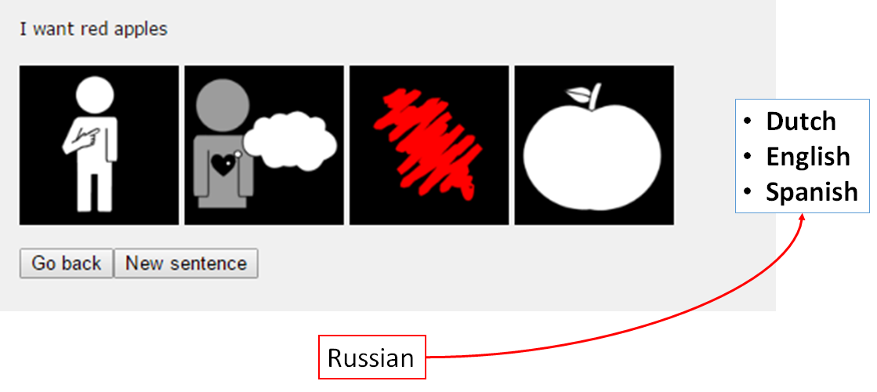
Text2Picto extension
Notes:
In particular, at KU Leuven University (Belgium), a system was developed to translate text in natural language into a sequence of pictograms for people with intellectual and speech impairments. A corresponding web service ”Text2Picto” was implemented, which allows translating text in Dutch, English, And Spanish. The flexible architecture of the project ”Text2Picto” makes it possible to add support for the translation of any natural language.
That`s why this project was chosen as a base to implement Russian text to pictographs translation by it`s extension.

Slide 6
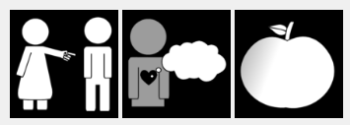
Web-service for translation pictographs into text
He
an apple
to want
Notes:
Unfortunately no existing system was found for translation pictographs into text. All current applications and systems provide “key-value” methods of translation without generation of coherent sentences.
Cause of it we get grammatically wrong sentence as a result of translation and such sentences can not be used for reading skills training or pronouncing by the speech synthesizer.

Slide 7
Web-service for translation pictographs into text
He
an apple
to want
He
wants
an apple
Notes:
All the pictographs of any notation are described in lemmas and some words forms could be modified by language grammatics.
Our goal was to find a way how to create coherent sentences from infinite sequences of lemmas.

Slide 8
Pictograph to text translation solutions
Methods
Templates
Machine learning
Notes:
There were found 2 different methods to solve the problem:
- Templates based method
And
- Deep machine learning method
Now we will shortly explain both of them.

Slide 9
Templates based method
Natural language
Syntax tree template
Template contains
properties of each word like
Part of speech
Animated or not
Gender
Number etc.
And dependencies between
tokens.
I am hungry
XML syntax tree
I play a game
XML syntax tree
This is my friend
XML syntax tree
Notes:
Templates based method
Main idea of this method is to create set of sentence templates for each case of input.
Templates were created automatically from natural language sentences and represented as a syntax trees in XML format.
Set of natural sentences was collected in rehabilitation center “Nadezhda” in Volzhsky city in Russia. This set represents most popular sentences using with pictographs.

Slide 10
Я
I
хотеть
to want
яблоко
an apple
pronoun
verb
noun
Я голоден
(I am hungry)
XML syntax tree
Я пою песню
(I sing a song)
XML syntax tree
Это мой друг
(This is my friend)
XML syntax tree
Я
I
хочу
want
яблоко
an apple
Notes:
This system gets infinite sequence of lemmas and and makes morphological analysis of each lemma. Then it tries to find the best existing template by non-morphological properties like part of speech and animation.

Slide 11
Templates based method
I
to want
an apple
I play a game
XML syntax tree
I
want
an apple
Notes:
After finding the best template we need to make all the lemmas the same form like in a found template declared.

Slide 12
Templates based method
- Hard to collect sentences manually
- Different templates can be found for the same input
- Works only for short messages
+ Easy to implement
+ Easy to extend
+ High translation speed
Notes:
Advantages and disadvantages are provided on this slide.

Slide 13
Deep learning based method
Parallel text corpora
English
Dutch
Deep learning
training model
RNN
Notes:
Deep learning based method
One of the way to create translation system is to train a Recurrent neural network. It should be trained on parallel text corpora with the same text on different languages. There are different frameworks for Python or Lua languages to train translation network provided on GitHub.

Slide 14
Deep learning based method
Он хочет играть
Мой друг не хочет играть
У нее есть хорошая идея
He wants to play
My friend does not want to play
She has a good idea
Он хотеть играть
Я друг не хотеть играть
У она есть хороший идея
He to want to play
My friend not to want to play
She to have good an idea
lemmatize
Parallel text corpora
Lemmatized sentences
Coherent sentences
Notes:
In our case source language is pictographic and target is a coherent text. As a source text we can use sequences of lemmas which represent translations of each pictograph and grammatically correct translations as a target.
To create such parallel corpora we have taken a big set of natural text sentences (1 million sentences) and lemmatized each of them to get lemmas sequences. This way we. got needed data for network training

Slide 15
Deep learning based method
800 000 sentences for training
200 000 for evaluation
Epoch | Accuracy | Perplexity
1 | 77.72 | 2.24
7 | 86.17 | 1.66
14 | 87.38 | 1.65
21 | 87.63 | 1.64
30 | 89.21 | 1.59
Notes:
As a framework for training network was chosen OpenNMT toolkit for python language. This toolkit supports GPU training using Nvidia Cuda Library to speed up the training process. We divided our 1 million sentences dataset into 2 parts. 800 thousands for training and 200 thousands for evaluation.
Training was set up for 30 epochs. During them accuracy of the model grown up from 77% to 89% and perplexity decreased to 1,5 value. Such properties of the model provide good quality of the translation.

Slide 16
Deep learning based method
Input:
I never to be America
Output:
I have never been to America
Input:
My mom to cook I a sandwich
Output:
My mom cooks me a sandwich
Notes:
Real testing shown good results of translation abilities of this model.
Such input as “I never to be America” was successfully translated into “I have never been to America” and “My mom to cook I a sandwich” into “My mom cooks me a sandwich”.
Each translation takes about 7 seconds of time.

Slide 17
Deep learning based method
+ Works with grammatically complicated sentences
+ No manually dataset collecting
+ High translation accuracy
- Hard to set up learning process
- Needs powerful firmware and GPU
- Each training session takes about 20 hours on Tesla GPU
Notes:
Advantages and disadvantages are provided on this slide.

Slide 18
Acknowledgements
The authors would like to thank Prof. J. Dekelver, Inclusion Research Coordinator at Thomas More University College (Geel, Belgium), and also staff and children from Regional Rehabilitation Center for disabled children Nadezhda (Volzhsky, Russia) for their assistance in designing and testing.

Slide 19
References
V. Vandeghinste and I. Schuurman, Linking Pictographs to Synsets: Sclera2Cornetto, in LREC 2012 Proceedings of the 9th International Conference on Language Resources and Evaluation, 2014, pp. 34043410.
M. Kultsova, R. Romanenko, I. Zhukova, A. Usov, N. Penskoy, T. Potapova, “Assistive mobile application for support of mobility and communication of people with IDD”, in Proc. MobileHCI ’16 Conf., Sep. 2016.
Text2Picto, http://webservices.ccl.kuleuven.be/picto/.
R. Mihalcea and C. Leong, Toward Communicating Simple Sentences Using Pictorial Representations, Machine Translation, vol. 22, no. 3, pp. 153173, 2009.
L. Sevens, V. Vandeghinste, and F. Van Eynde, Improving the Precision of Synset Links Between Cornetto and Princeton WordNet, in LG-LP 2014 Proceedings of the COLING Workshop on Lexical and Grammatical Resources for Language Processing, 2014.
Notes:
Technologies which were used to implement an algorithm are:
- Perl language and WordNet for natural language representation and processing
Postgres for database storage and relations representation between wordnets and pictures
HTML + Javascript for frontend representation for browser usage of this project.
- For translation integration into the other project REST-API was implemented.

Slide 20
Thanks for your attention

